Slide 1
CyberScan AI
Distributed Machine Learning for Malware Detection
Ofek Bar-Shalom & Nadav Cohen
Cyber Attack Detection Methods
Ariel University • Department of Computer Science

Slide 2
The Challenge
macOS malware detection rates 2x higher than Windows per device
Traditional static signatures fail against packed & obfuscated binaries
Modern malware employs evasion & persistence techniques (rootkits, dynamic payloads)
Need for explainable, scalable ML detection on macOS

Slide 3
Our Solution: CyberScan AI
A distributed, asynchronous ML-powered system that separates file ingestion from heavy analysis:
FastAPI Web Server – Accepts file uploads and provides instant feedback
Redis Message Broker – Queues analysis tasks for scalable processing
Worker Pool – Runs ML model on Mach-O binaries in parallel
Analytics Dashboard – Real-time metrics and detection results

Slide 4
System Design: Microservices Architecture
FastAPI (Web)
REST API for file uploads, task tracking, and result retrieval
Redis Broker
Job queue for async task distribution and worker coordination
Worker (ML)
Feature extraction via LIEF, model inference using Random Forest

Slide 5
Asynchronous Task Pattern
1. Upload – User uploads binary via web UI to FastAPI
2. Queue – Task pushed to Redis job queue with unique task_id
3. Process – Scalable workers pop tasks, extract features, run model
4. Deliver – Results stored as JSON. user retrieves via API or dashboard

Slide 6
Docker & Deployment
docker-compose.yml orchestrates the full stack:
Web Container – FastAPI server on port 8000
Redis Container – Message broker on port 6379
Worker Container – Scalable analysis engine (RQ-based)
Shared volume – Data persistence (temp_uploads/, data/)

Slide 7
Feature Extraction & ML Pipeline
Dataset: 1,070 malware + 734 benign samples | 97.5% Accuracy
📦 size
📂 n_sections
📥 n_imports
Numeric: Binary file size (bytes)
Numeric: Mach-O section count
Numeric: Imported functions
⚠️ suspicious_count
📤 n_exports
✓ has_sig
Numeric: Suspicious APIs detected
Numeric: Exported functions
Boolean: Signature presence
🔐 entropy
Numeric: Shannon entropy of binary (packing detection)

Slide 8
Machine Learning: Random Forest Classifier
Why Random Forest?
Performance Metrics:
Handles feature interaction well
Robust to obfuscated samples
Feature importance ranking
Accuracy: 97.5%+
Precision: High
Recall: Balanced

Slide 9
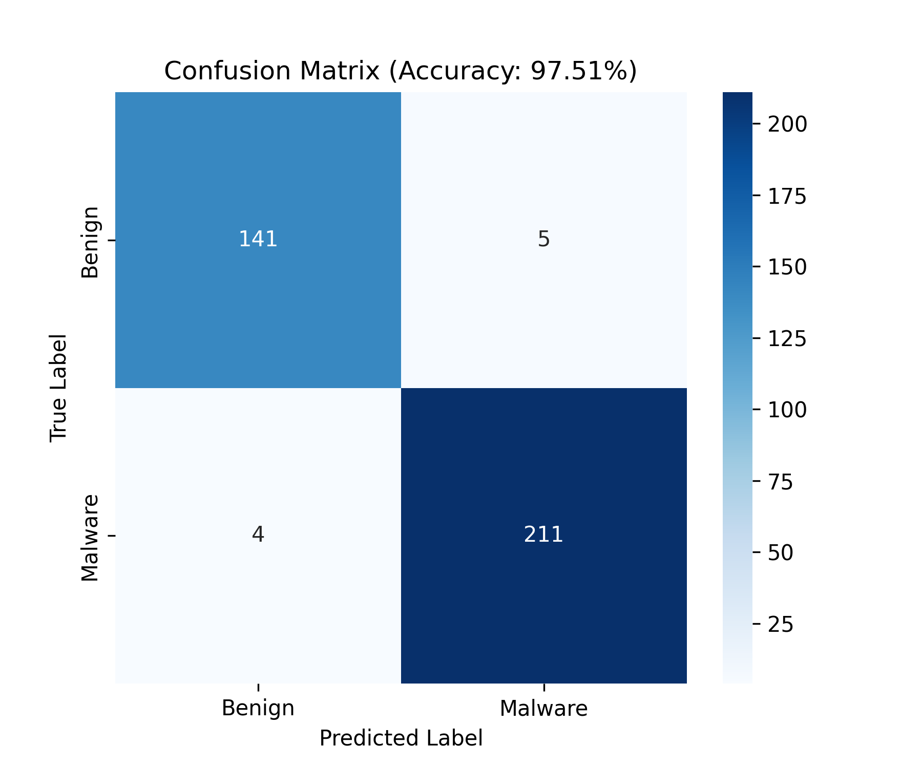
Model Evaluation: Confusion Matrix

Slide 10
Live Docker Demo: Getting Started
Step 1: Launch the Stack
docker-compose up --build
Step 2: Access Web UI
http://localhost:8000
Step 3: Scale Workers (Optional)
docker-compose up --scale worker=3 -d

Slide 11
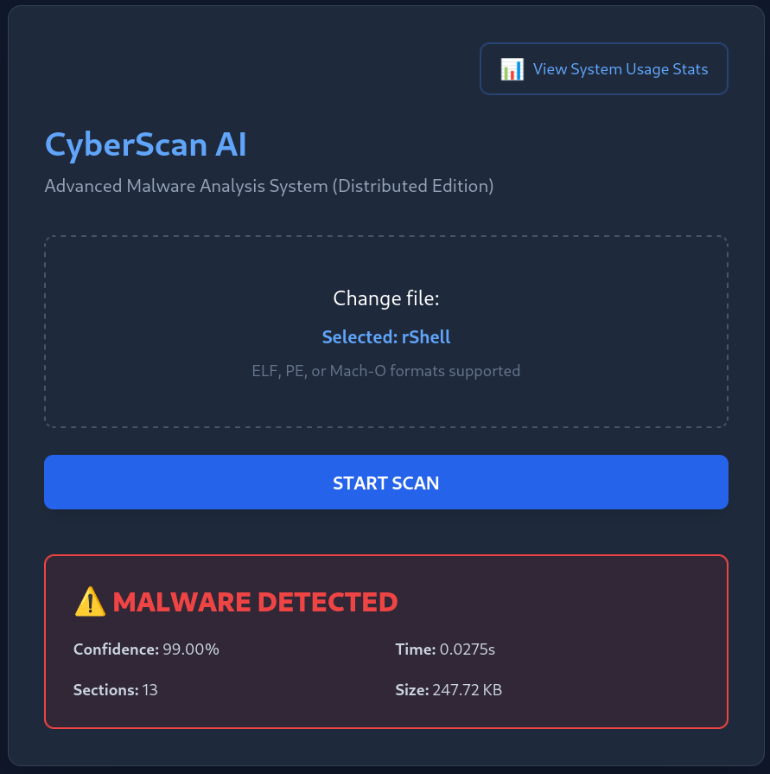
Dashboard Features & Live Interface

Slide 12
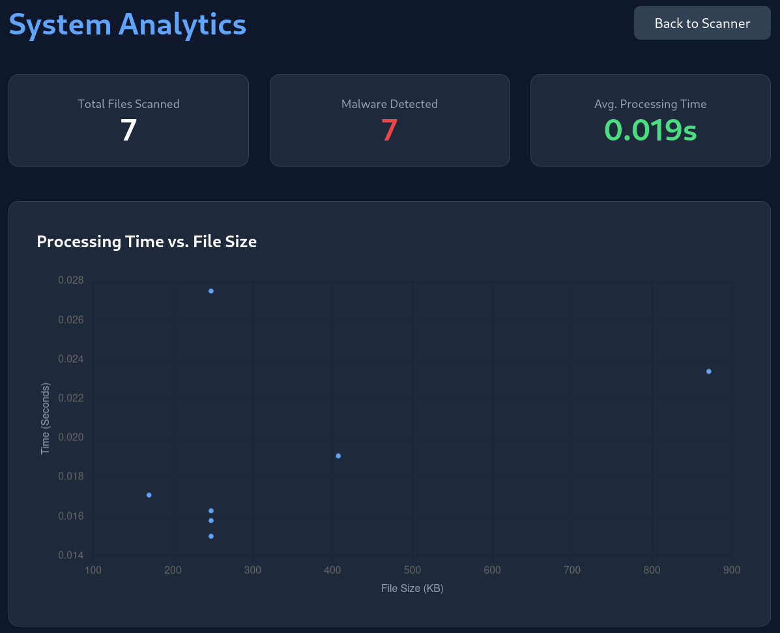
Dashboard Features & Live Interface

Slide 13
Questions?
CyberScan AI: Distributed ML for Malware Detection
Ofek Bar-Shalom & Nadav Cohen

